Slide 1
WEB APPLICATIONS
Introduction, Structure, Examples

Slide 2
Introduction:
Web browsers are software applications that allow users to retrieve data and interact with content located on web pages within a website.
Modern web pages allow personalized dynamic content to be pulled down by users according to individual parameters, tracked user behavior, preferences and security considerations.
Most importantly, modern web sites allow the capture, processing, storage and transmission of sensitive customer data (e.g., personal details, credit card numbers, social security information, etc.) for immediate and recurrent use. And, this is done through web applications.

Slide 3
Web Applications: (Definitions)
A web application or web app is any software that runs in a web browser. OR
A Web application (Web app) is an application program that is stored on a remote server and delivered over the Internet through a browser interface. OR
Web applications query the content server and dynamically generate web documents to serve to the client. OR
It is a client/server application that uses a Web browser as its client program, and performs an interactive service by connecting with servers over the Internet (or Intranet).

Slide 4
Advantages of Web Applications:
Reduces website size.
Generates updated and customized information
They perform their function irrespective of the operating system
Quickly deployed anywhere at no cost.
No installation requirements at the user’s end.
Allows visitors to submit and retrieve data to/from a database over the Internet.

Slide 5
Structure & Working of Web-App
Applications are usually broken into logical chunks called "tiers”.
Every tier is assigned a role.
Traditional applications consist only of 1 tier and resides on the client machine.(when offline)
Web applications lend themselves to an n-tiered approach by nature.
Many variations are possible, the most common structure is the three-tiered applications such as presentation, application
and storage
In this order. A web browser is the first tier (presentation.
An engine using some dynamic Web content technology (such as ASP, ColdFusion, JSP/Java, PHP) is the middle tier (application logic).
And a database is the third tier (storage).

Slide 6
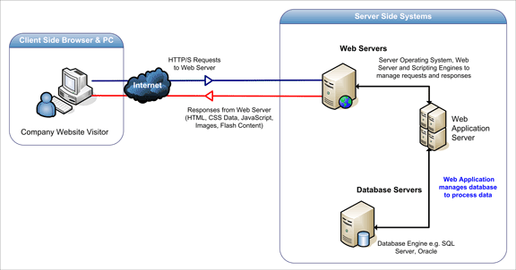
Structure & Working of Web-App
The web browser sends requests to the middle tier, which services them by making queries and updates against the database and generates a user interface.

Slide 7
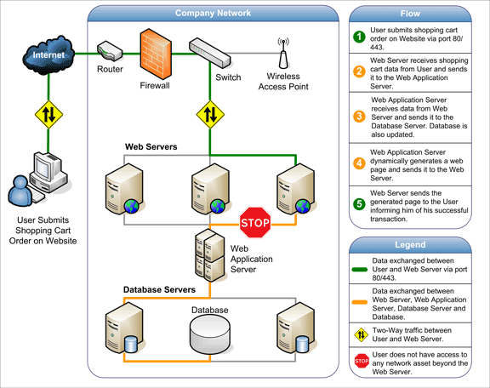
The figure below shows how the initial request is triggered by the user through the browser over the Internet to the web application server. The web application accesses the databases servers to perform the requested task updating and retrieving the information lying within the database. The web application then presents the information to the user through the browser.

Slide 8
TCP/IP
A protocol suite developed in 1980s to manage and control computer networking on the Internet and similar computer networks.
TCP/IP provides end-to-end connectivity specifying how data should be packetized, addressed, transmitted, routed and received at the destination.
TCP/IP functionality is organized into four abstraction layers, used to sort all related protocols (as a protocol stack) according to the scope of networking involved.
The TCP/IP model and other protocol models are maintained by the Internet Engineering Task Force (IETF).

Slide 9
04 Abstraction Layers of TCP/IP
From lowest to highest, the Network Interface layer , containing communication technologies for a single network segment (link),
The internet layer, connecting hosts across independent networks, thus establishing Inter-networking, The Internet layer provides the mechanisms for controlling message routing, validity checking, and message header composition/ decomposition. The protocol known as IP (which stands, oddly enough, for Internet Protocol) operates on this layer, as does ICMP (the Internet Control Message Protocol) which handles the transmission of control and error messages between systems.

Slide 10
04 Abstraction Layers of TCP/IP
The transport layer, provides message transport services between applications running on remote systems. This is the layer in which TCP (the Transmission Control Protocol) operates. TCP provides reliable, connection-oriented message transport.
The application layer, which provides process-to-process application data exchange. It means that within this layer the most of the services we associate with ‘the Internet’ operate.

Slide 11
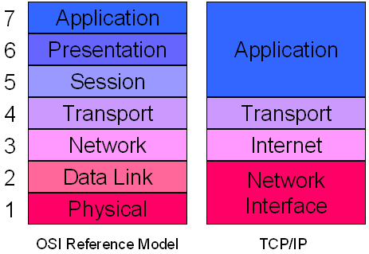
Comparison of TCP/IP and OSI layering
Following are the names of Internet layers that map with the OSI model’s layers:
Application layer is equivalent to OSI model’s Application, Presentation and Session layers
Transport Layer is equivalent to OSI model’s Transport layer
Internet layer is equivalent to OSI model’s Network layer
Network Interface layer is equivalent to OSI model’s data link layer

